Slide 1
Mastering the Architecture Design Session (ADS)
Joel Hulen

Slide 2
Abstract and learning objectives
Abstract A facilitated discussion around top Architecture Design Session (ADS) tips & tricks, this session focuses on what makes a great ADS, from requirements collection to architecture.
Learning objectives
Analyze useful ADS techniques and when to use them.
Provide suggestions on ways to improve practices in delivering an ADS.
Propose methods of evaluating and coaching peers in delivering an ADS.

Slide 3


Basics
An Architecture Design Session (ADS) is a one- to multi-day engagement driven by technical sales that maps technical solutions to customer opportunities

Slide 4
Requirements for success
1. Preparation
You will need significant time for planning prior to the engagement and for collaboration during the engagement.
2. Delivery
You will identify the opportunity and current state, whiteboard and develop possible solutions for the future state, and propose an implementation plan.
3. Follow-up
An ADS is one effective way to land on a shared vision and scope.
Notes:
To successfully lead an ADS, you will need significant time for planning prior to the engagement and for collaboration during the engagement.
In the session, you will identify the opportunity and current state, whiteboard and develop possible solutions for the future state, and propose an implementation plan.
Delivering an ADS is one effective way to land on a shared vision and scope.

Slide 5
The goal of an ADS is to help the customer get a working solution deployed. This may be via a pilot that will release into production or one or more POCs that de-risk critical aspects.
ADS outcomes
Notes:
Your ADS may involve delivering technical artifacts in addition to documentation and a detailed plan. Building a pilot that runs in your customer’s Azure subscription is most likely your goal. Sometimes you need to proof-out or de-risk certain aspects of the design by creating a POC. There are some benefits to doing this:
Builds confidence
Creates trust
Ensures successful pilot
As a technical seller, you'll tend to prefer pilots because they get the meter going in the customer's subscription. However, does not diminish the value of POCs, as they may be created en route to the pilot.
A proof of concept is meant to overcome customer objections by demonstrating the solution will solve the problem for which it is designed. Treat a POC as a continuous learning and improvement process for the solution. A rapid execution tempo of the POC helps validate the customer’s requirements, while giving them confidence in your ability to deliver on your promises. A successful POC can serve as evidence that your practice can use for future engagements with your customer or new ones. In fact, many times the output of a POC can be added to your practice’s intellectual property list for demonstrations, or used to accelerate future solutions.

Slide 6
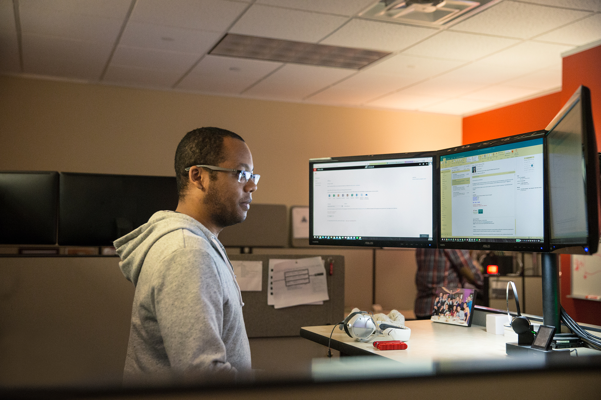

Preparation (1/3)
Initial meeting between the opportunity manager and technical sales (TSP or CSA)
Verify that the collaborative problem-solving approach of an ADS is the best engagement option.
A product briefing or demonstration is better for information on our systems.
Hands-on labs or trainings are better for providing experience with our systems.
Notes:
Bullet points represent alternatives to an ADS

Slide 7

Preparation (2/3)
Planning call with the customer, opportunity manager, and technical sales
Prepare a meeting agenda
Opportunity goals, objectives, and scope
General outline of the existing system
Agenda
Location (not customer site if possible)
Verify that you have the appropriate guest list
Customer attendees (decision makers):
Sponsor, Business representative(s), Project manager
Technical representative(s) (depending on project: Advisors/partners, Architecture, Development, Infrastructure, Operations, Security)
Microsoft attendees
Architect (facilitates session), SMEs (depending on project), account team
Notes:
Prepare a meeting agenda.
Opportunity goals, objectives, and scope
General outline of the existing system
Agenda
Location (not customer site if possible)
Verify that you have the appropriate guest list for the engagement.
Customer attendees (decision makers):
Sponsor, Business representative(s), Project manager
Technical representative(s) (depending on project: Advisors/partners, Architecture, Development, Infrastructure, Operations, Security)
Microsoft attendees
Architect (facilitates session), SMEs (depending on project), Account team

Slide 8

Preparation (3/3)
Develop possible solutions, an implementation plan, and a meeting agenda
Design
Create a technical solution proposal based on reference architectures.
Plan
Create a phased implementation plan proposal that allows the customer to control cost and schedule impacts.
Participants
Identify key players for each section of the ADS and prepare a meeting agenda.

Slide 9
Sample agenda
Before the ADS
Preliminary requirements clarification | 9:00 am - 9:30 am
Ideation & Baseline/Candidate Architecture Discussion | 9:30 am - 10:30 am
During the ADS
 | Day 1
Detailed discovery | 9:00 am - 12:00 pm
Envisioning | 1:00 pm - 5:00 pm
 | Day 2
Whiteboard Candidate Architecture(s) | 9:00 am - 12:00 pm
Identify and define POC and Pilot(s) | 1:00 pm – 4:00 pm
Document high level deliverables and next action steps | 4:00 pm – 5:00 pm
This work can be performed remotely.
After the ADS
Create architecture diagrams | *Varies by project
Review architecture diagrams with ADS team | 9:30 am - 10:30 am
The ADS should be performed in-person.
This work can be performed remotely.

Slide 10
Complete the pre-ADS checklist
A successful architecture design session relies on preparation. After the ideation, or opportunity definition session, perform the following checklist of items to prepare for the ADS:
Schedule a time: Typically 1-2 days or a design session
Schedule a location: Ensure you have whiteboards and a projector
Schedule resources: Experts from your team, and a cross-cutting panel of technical and business stakeholders from the customer
Build an agenda: Establish milestone goals in advance so that the ADS doesn’t get consumed discussing a single topic
Prepare preliminary documentation and architectural diagrams, such as baseline architecture. Even if you only have the basic building blocks, it’s good to come prepared with something you can modify during or after the session.
Notes:
. This could be information might be handed to you by others in the pipeline such as an SSP (solutions sales professional), or possibly account executive

Slide 11
What are your proven practices in preparing for an ADS?

Slide 12
Delivery
Whiteboards and Surface Hub support the type of collaboration you’ll need for a successful ADS.
Focus on your stakeholders, use the whiteboard as a tool for recording ideas, and get approval at each step before moving forward.

Slide 13

Discovery Checklist
Allow ~3 hours
Work with your group to review and whiteboard customer requirements, using prepared notes and diagrams from the ideation session as a guide.
Be sure to do the following:
Ensure customer background & business strategy is understood.
Clarify the project background and its drivers/aims.
Cover the technology landscape: Do they require a hybrid solution or 100% cloud, what is the current technology competency of the team if they will be maintaining the solution, has the customer proposed technologies they’d like to use.
Go over usage scenarios for the solution, from the perspective of their internal and external users.
Take down all upfront functional and non-functional requirements.

Slide 14
Envisioning Checklist
Allow ~4 hours
Work with your group to brainstorm the solution approach, based on details captured from the discovery and ideation sessions.
Be sure to do the following:
Key functionalities and capabilities of the solution to meet functional requirements and goals
Components of the solution (e.g. which app services, data services, client side software, identity services, etc.)
Security considerations (TLS, identity, authorization, etc.)
Compliance considerations (HIPAA, PCI, etc.)
Identify external connections and integration points (APIs, business intelligence)
Map requirements and scenarios to the proposed solution components

Slide 15
Planning Checklist
Allow ~8 hours
Work with your group to establish a plan of action and parameters of deliverables, required resources, milestones, and deciding on POC or pilot opportunities and requirements.
Be sure to do the following:
Establish proof points
Identify exclusions, risks, and issues (refine solution functionality)
List project pre-requisites (legal, funding, technical, etc.)
List required resources
Notate long-term project plans (continued maintenance, training, handover to customer’s technical staff)
Establish parameters of communication (primary proof-testing, preferred means of communication, frequency of meetings, whether conducted in person or virtually, and how often)
Identify candidates for technology or design POC/prototype
Identify an opportunity for a pilot
Consider if POC or pilot is appropriate as the next step
Establish solution deliverables, including for POC or pilot if applicable

Slide 16
Decision Tree – POC or Pilot?
When choosing between implementing a POC or a pilot for a given scope, consider the following questions to help you make your decision:
Will proving the scope out earlier risk the overall project?
yes
no
Is there uncertainty about the recommended technology/architecture?
Start
yes
no
Does it need to release into production?
Is the technology/architecture unfamiliar to the customer?
no
yes
yes
no
Build a Pilot
Build a POC
Build neither POC or Pilot, deliver as part of solution

Slide 17

Whiteboarding Tips
Start with a proven practice whiteboard layout.
Use standard icons from the Microsoft Cloud & Enterprise symbol set.
Memorize your frequently used icons so you can sketch them quickly and be consistent.
Use the design to confirm your understanding with the customer.
Refine the whiteboard “sketch” in Visio or PowerPoint.
Notes:
During the ADS, you and your customer planned a high-level architecture and conceptual design for a solution that addresses their organization’s business goals and technical requirements.

Slide 18
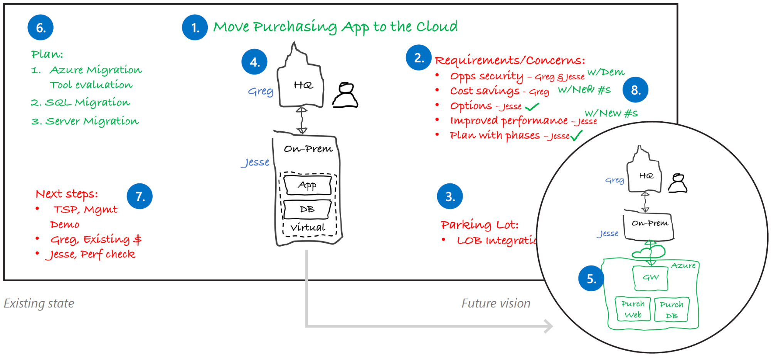
Proven practice whiteboard layout
Project Goal
Requirements & concerns
Parking lot
Current State
Future Vision
Implementation plan
Next steps
Wrap-up
Notes:
1. Project goal
Write down the project goal to help focus everyone to the desired outcomes.
2. Requirements and concerns
Begin with the items you’ve listed from the pre-call. Make sure that everyone gets a chance to be heard. Write down names next to each person’s requirements or concerns.
3. Parking lot
Acknowledge out-of-scope items. Help people set these concerns aside for later and focus back on the topic at hand.
4. Current state
Diagram the current state and ownership in black. The customer may help diagram this on the whiteboard. Be careful with technical depth. Focus on the system details that affect the ADS outcomes.
5. Future vision
Capture a high-level view of what the customer really wants in green before diving into technologies. Help customers envision the potential opportunities with Microsoft technologies.
6. Implementation plan
Break the plan into clear steps so the customer can track the project schedule and budget flexibility.
7. Next steps
Assign immediate action items during the meeting.
8. Wrap-up
Verify with all stakeholders that their requirements and concerns have been sufficiently addressed with the solution and plan. Close with agreement on the next steps.

Slide 19
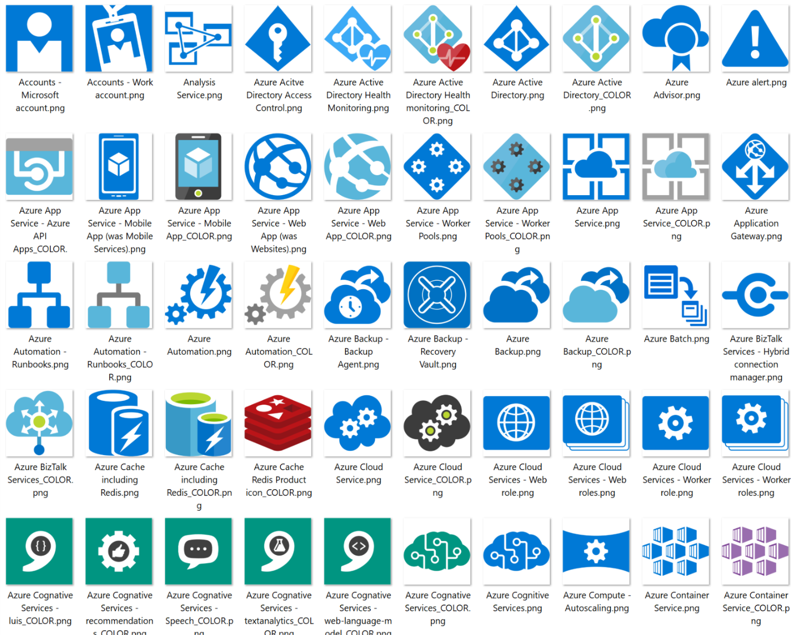
Use standard icons for Azure services
All icons available under the Symbols\CNE_Cloud folder.
Files types in package
Visio Stencil (.vss)
PNG file
SVG file
Download the Microsoft Azure, Cloud and Enterprise Symbol/Icon Set
https://www.microsoft.com/en-us/download/details.aspx?id=41937
Notes:
Microsoft has made available icon libraries for PowerPoint (as PNG files) and Visio that simplify creating great diagrams using standardized icons for Azure services.

Slide 20

What makes a good whiteboard design?

Slide 21
What are your proven practices for delivering an ADS?

Slide 22
Follow-up documentation
Email the meeting notes and a draft of the vision and scope to the ADS participants.
Include:
Photos of the board(s)
Key decisions made
Document:
Requirements and concerns
Implementation plan
Next steps and action items
A formal illustration of the current state and proposed solution in PowerPoint or Visio

Slide 23
After the ADS Checklist
During the ADS, you and your customer planned a high-level architecture and conceptual design for a solution that addresses their organization’s business goals and technical requirements. After the ADS, you’ll deliver the following:
Summary of the ADS engagement with customer
A proposed timeline of solution deliverables, including deliverables for POC or pilot if applicable
Final architecture diagrams for customer to sign off
Special areas of concern, such as security, compliance, and compatibility
Proposed Microsoft and open source/3rd party technologies to be used for the solution, listing any trade-offs amongst differing technology options
Complete deployment plan with specific examples, covering development, staging, and production targets where applicable
Showcase of the capabilities of your solution to deliver business value on premises and/or the cloud

Slide 24
What are your proven practices when following up after an ADS?

Slide 25
CSU Intelligent Cloud Customer Journeys microsoft.sharepoint.com/teams/CSUCustomerJourneyRoadmap

Slide 26
Pre-event self-appraisals
Please help us measure the impact of this week’s training by completing the following self-appraisals:
Technical selling self-appraisal
http://bit.ly/ads-pre-event-tech-selling
Technical delivery self-appraisal
http://bit.ly/ads-pre-event-tech-delivery

